Slide 1
Linux Virtual Machines: The Azure Cloud Platform
Dr. Leon Jololian

Slide 2
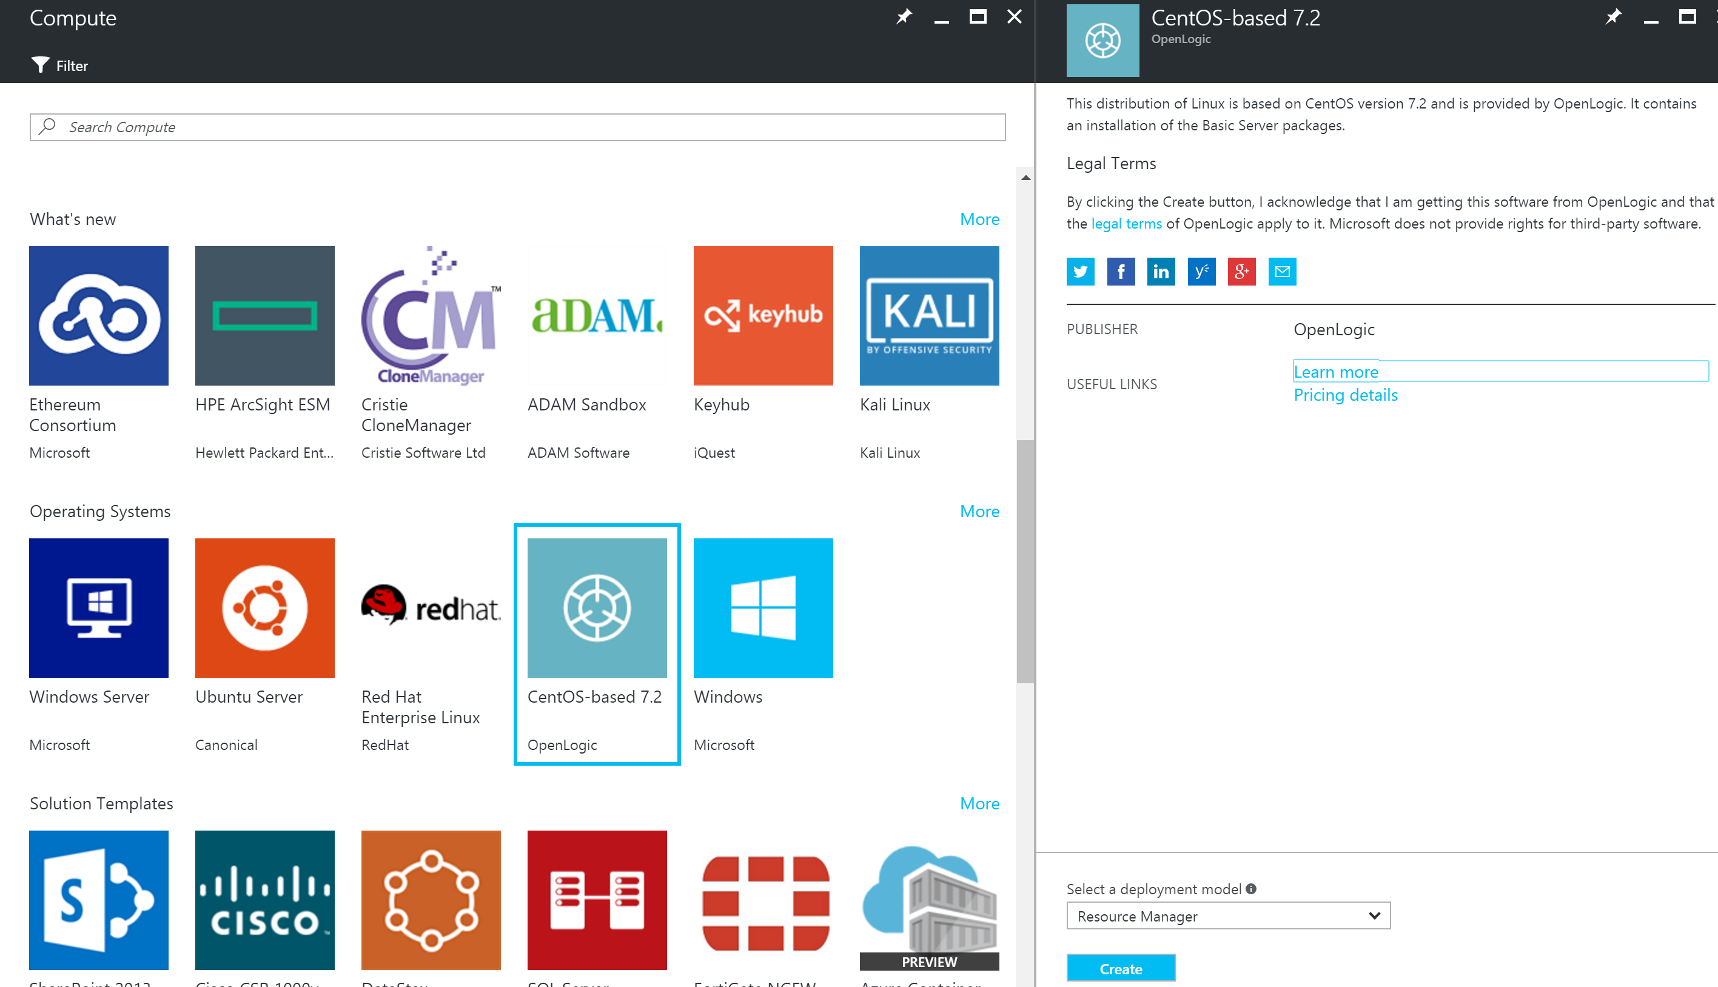
Provisioning a Linux VM
Provision a VM with the operating system: Centos-based 7.4

Slide 3
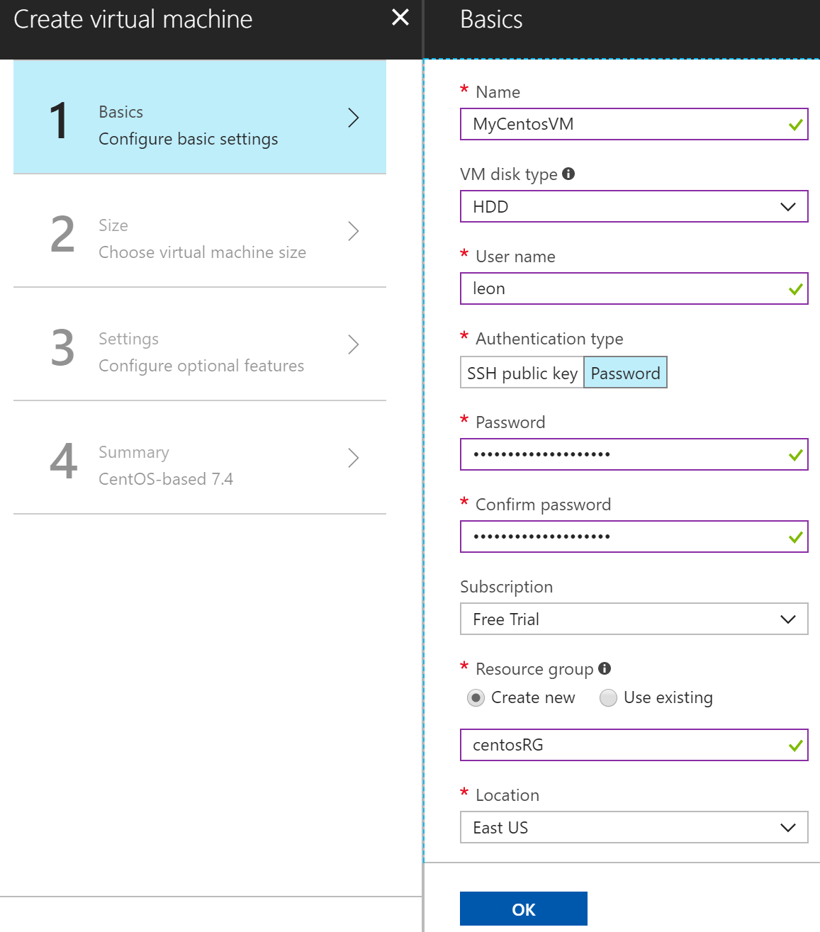

Slide 4
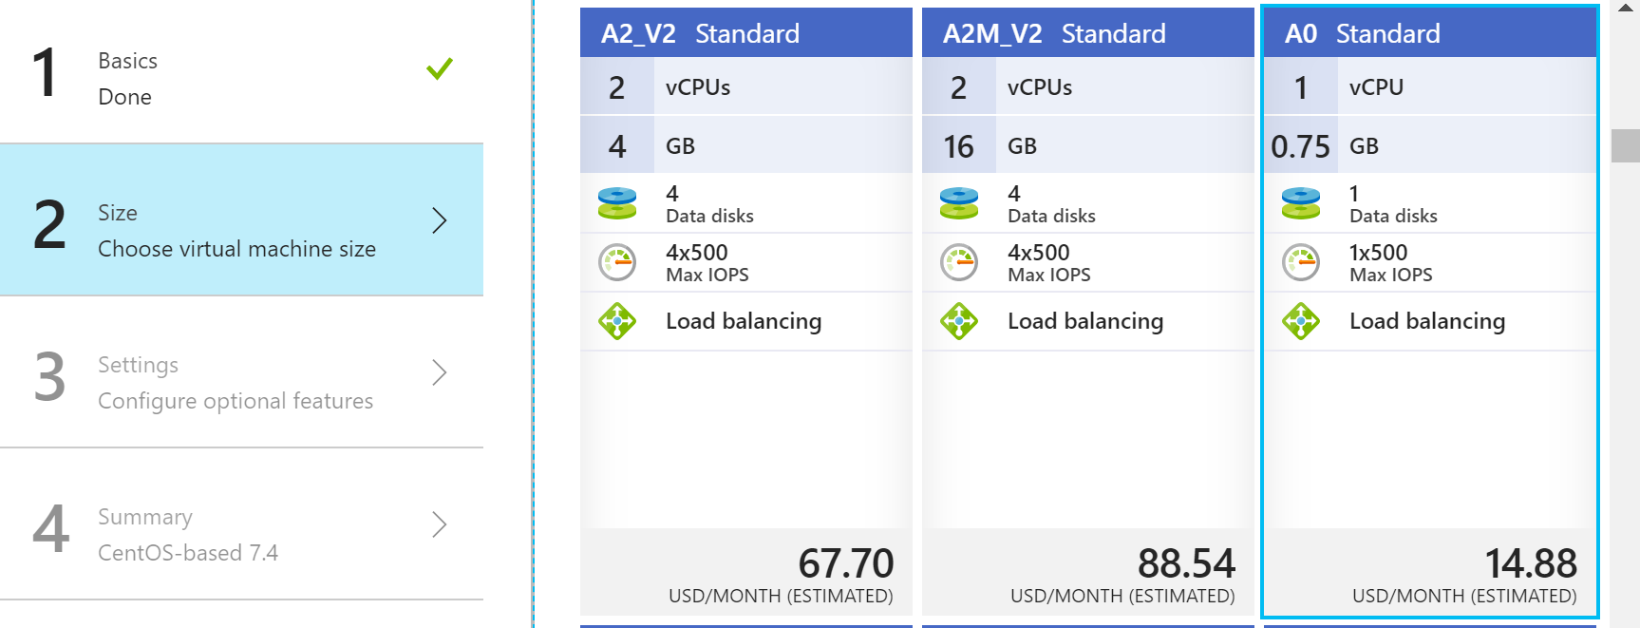

Slide 5
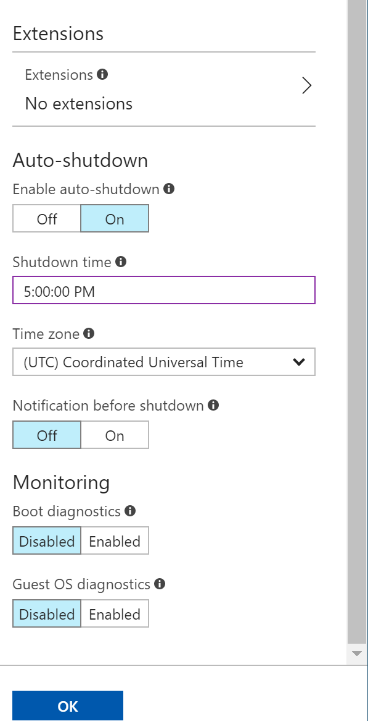
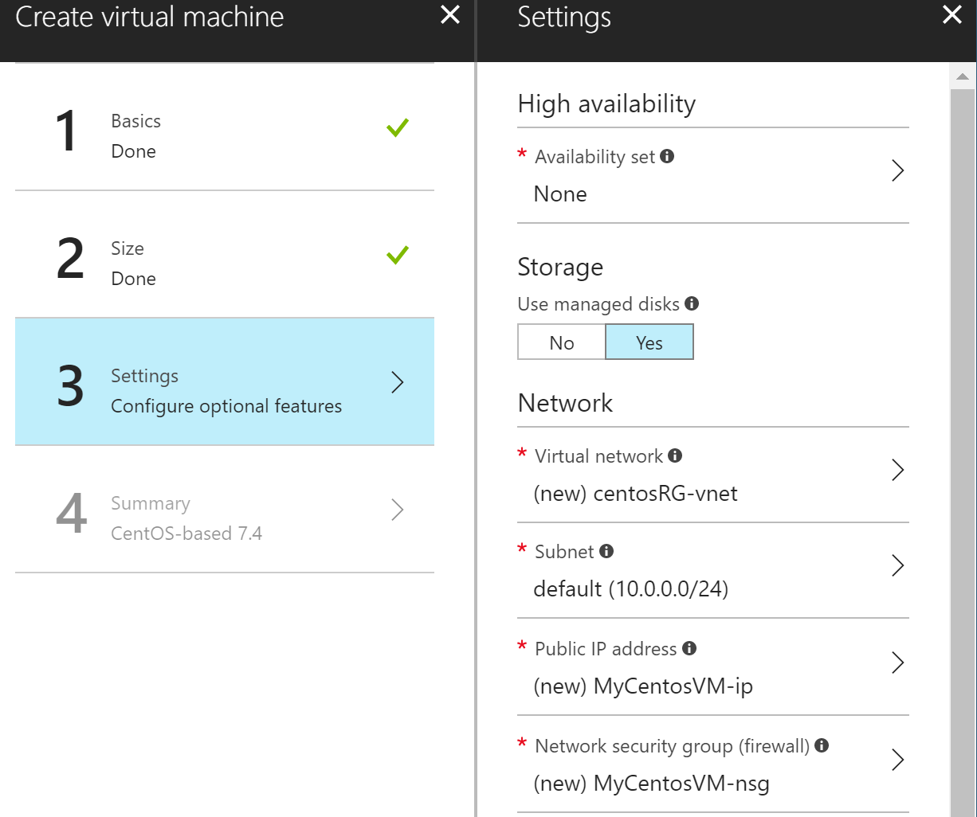

Slide 6
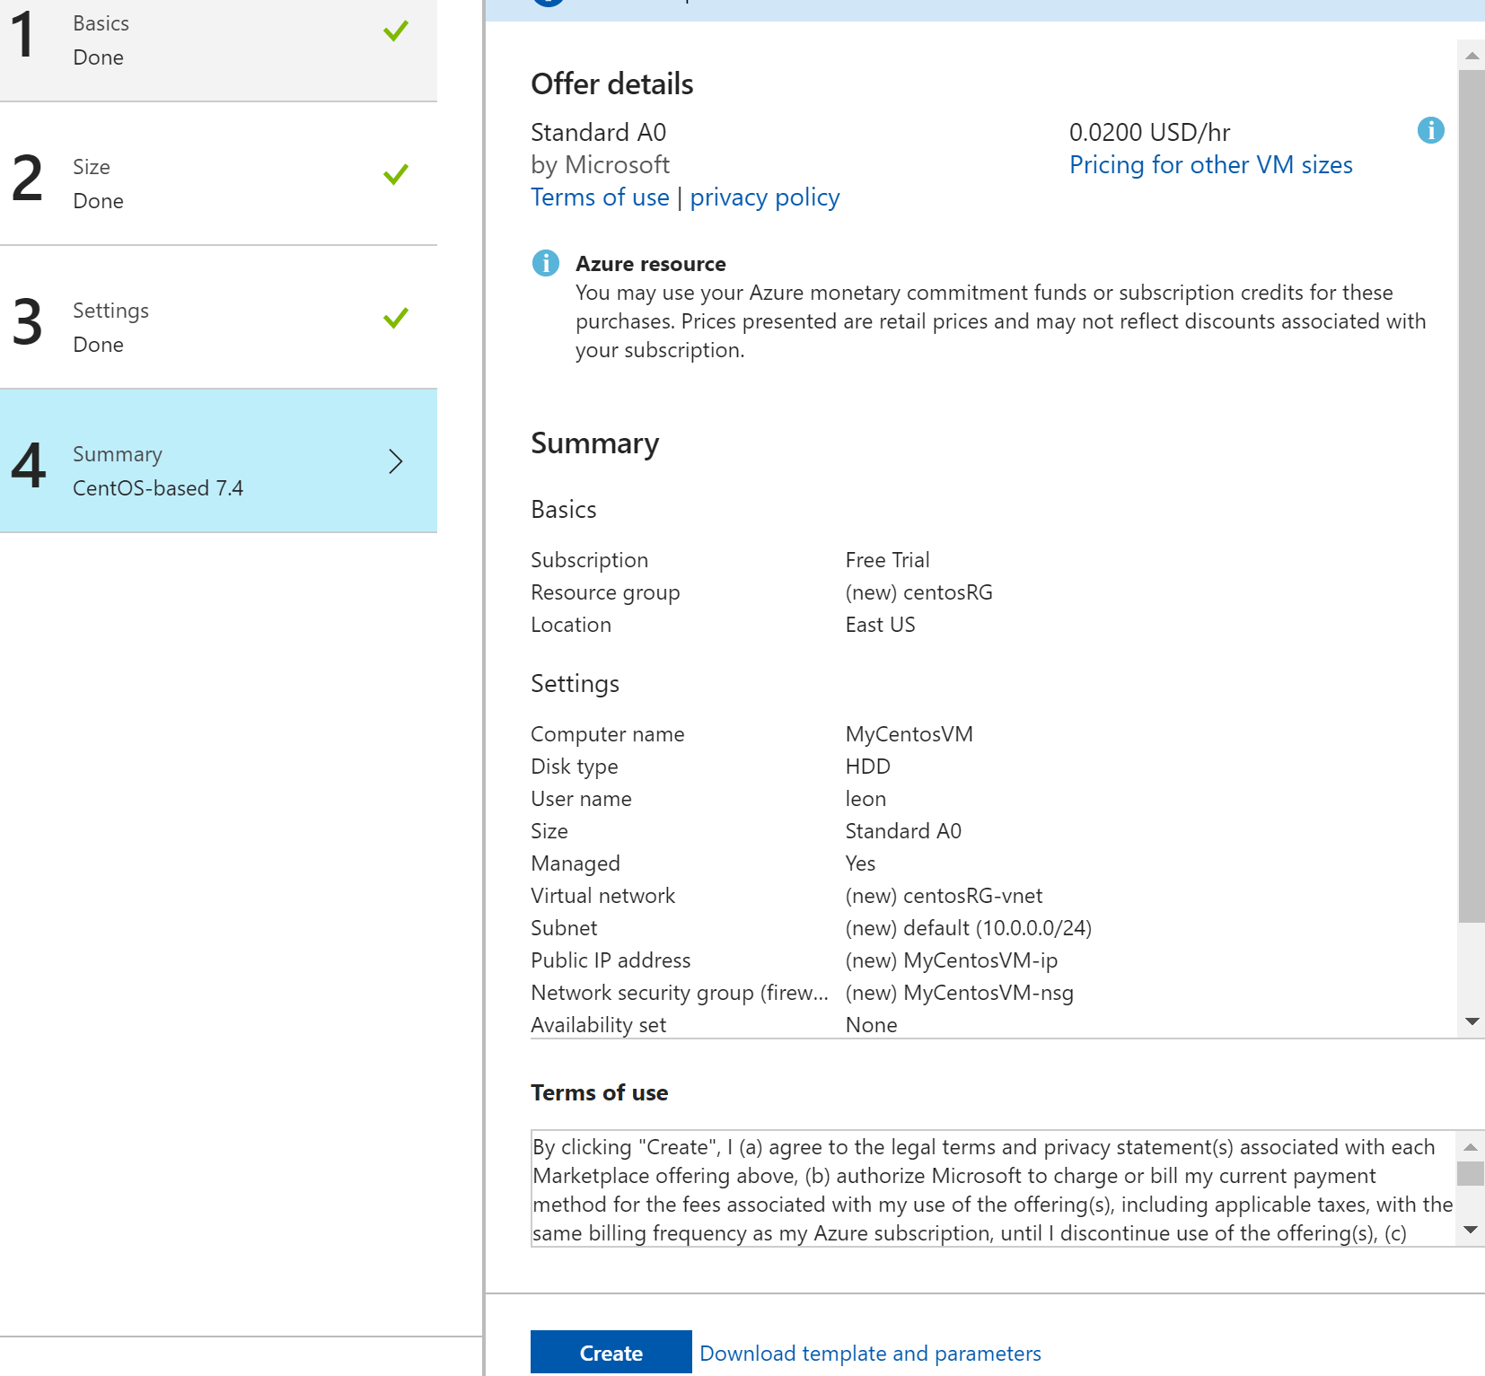

Slide 7
Connecting to VM with a SSH Client
PuTTY is an SSH and telnet client, developed originally for the Windows platform
PuTTY is open source software that is available with source code and is developed and supported by a group of volunteers
You can download PuTTY from: http://www.chiark.greenend.org.uk/~sgtatham/putty/download.html

Slide 8
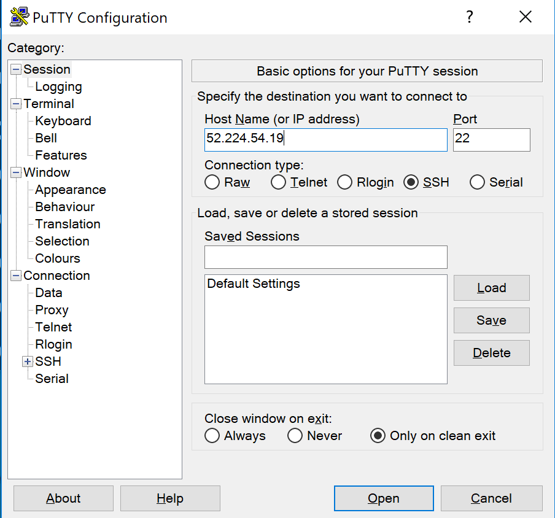
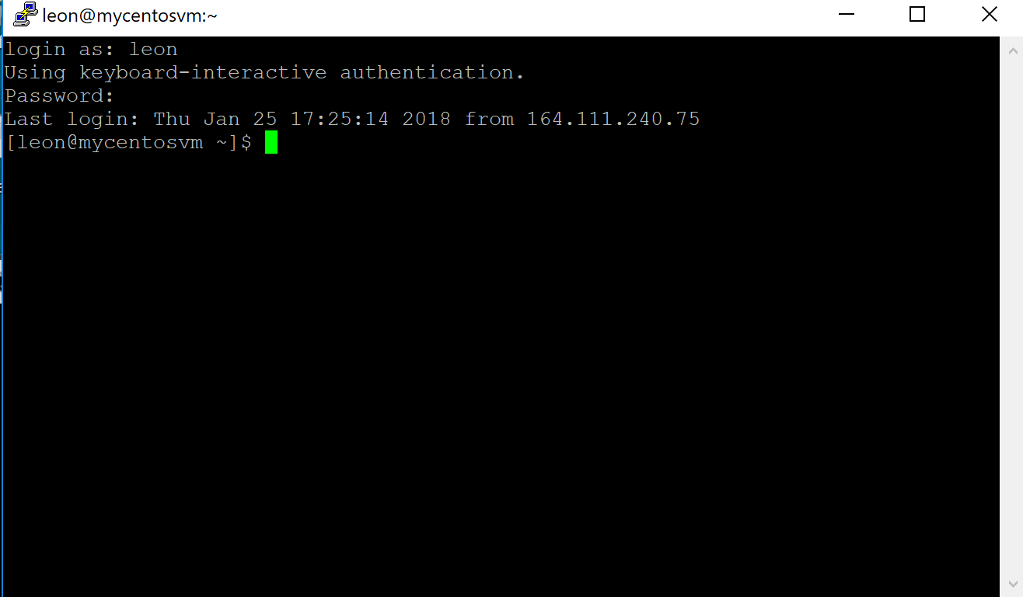
Logging in the VM
From your local Widows PC, open a command window. type the command: ssh username@host, where the username and hostname refer to the user and host related to the VM.
Alternatively, on your local Windows PC, run putty and enter your host IP. You will be prompted for the VM’s user name/password:

Slide 9
Installing HTTP server
$ sudo yum install -y httpd
We trust you have received the usual lecture from the local System Administrator. It usually boils down to these three things:
#1) Respect the privacy of others.
#2) Think before you type.
#3) With great power comes great responsibility.
[sudo] password for xxx:
…
Complete!

Slide 10
Running HTTP server
To start server:
$ sudo /sbin/apachectl start
Other commands: stop, restart, and status
To verify process is running
$ ps ax | grep httpd
Open port 80
Point browser to IP of VM

Slide 11
Configuring HTTP Server
Configuration file:
/etc/httpd/conf/httpd.conf
The default Html document directory is
/var/www/html
Create a sample index.html file and verify that you are able to access it from any browser.

Slide 12
Create New Public and Private Keys
Launch PuTTYgen from the Windows Programs list and proceed with the following steps:
Under Parameters, increase the Number of bits in a generated key: to a minimum value of 2048.
Under Actions / Generate a public/private key pair, click Generate.
You will be instructed to move the mouse cursor around within the PuTTY Key Generator window as a randomizer to generate the private key.
Once the key information appears, click Save private key under Actions / Save the generated key.
Save the private key to the desktop as id_rsa.ppk.
The box under Key / Public key for pasting into OpenSSH authorized_keys file: contains the public key.

Slide 13
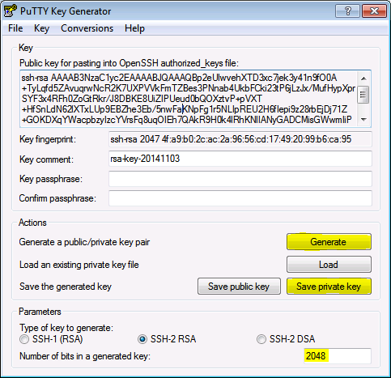

Slide 14
Copy Public Key to Server
The OpenSSH public key is located in the box under Key / Public key for pasting info OpenSSH authorized_keys file:. The public key begins with ssh-rsa followed by a string of characters.
Highlight entire public key within the PuTTY Key Generator and copy the text.
Launch PuTTY and log into the remote server with your existing user credentials.
Use your preferred text editor to create and/or open the authorized_keys file:
vi ~/.ssh/authorized_keys
Paste the public key into the authorized_keys file.
Save the file and close the text editor.
Adjust the permissions of the authorized_keys file so that the file does not allow group writable permissions.
chmod 600 ~/.ssh/authorized_keys
Logout of the remote server.

Slide 15
Connect to Server with Private Key
Now it is time to test SSH key authentication. The PuTTYgen tool can be closed and PuTTY launched again:
Enter the remote server Host Name or IP address under Session.
Navigate to Connection > SSH > Auth.
Click Browse... under Authentication parameters / Private key file for authentication.
Locate the id_rsa.ppk private key and click Open.
Finally, click Open again to log into the remote server with key pair authentication.

Slide 16
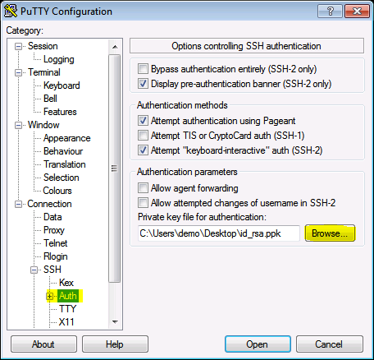

Slide 17
Create a Linux VM with PowerShell
Create resource group:
New-AzureRmResourceGroup -Name myRG -Location eastus
Create a virtual network, subnet, and a public IP address:
# Create a subnet configuration
$subnetConfig = New-AzureRmVirtualNetworkSubnetConfig -Name mySubnet -AddressPrefix 192.168.1.0/24
# Create a virtual network
$vnet = New-AzureRmVirtualNetwork -ResourceGroupName myRG -Location eastus `
-Name MYvNET -AddressPrefix 192.168.0.0/16 -Subnet $subnetConfig

Slide 18
# Create a public IP address and specify a DNS name
$pip = New-AzureRmPublicIpAddress -ResourceGroupName myRG -Location eastus `
-AllocationMethod Static -IdleTimeoutInMinutes 4 -Name "mypublicdns$(Get-Random)"
Create a network security group and a network security group rule:
# Create an inbound network security group rule for port 22
$nsgRuleSSH = New-AzureRmNetworkSecurityRuleConfig -Name myNetworkSecurityGroupRuleSSH -Protocol Tcp `
-Direction Inbound -Priority 1000 -SourceAddressPrefix * -SourcePortRange * -DestinationAddressPrefix * `
-DestinationPortRange 22 -Access Allow
# Create an inbound network security group rule for port 80
$nsgRuleWeb = New-AzureRmNetworkSecurityRuleConfig -Name myNetworkSecurityGroupRuleWWW -Protocol Tcp `
-Direction Inbound -Priority 1001 -SourceAddressPrefix * -SourcePortRange * -DestinationAddressPrefix * `
-DestinationPortRange 80 -Access Allow

Slide 19
# Create a network security group
$nsg = New-AzureRmNetworkSecurityGroup -ResourceGroupName myRG -Location eastus `
-Name myNSG -SecurityRules $nsgRuleSSH,$nsgRuleWeb
# Create a virtual network card and associate with public IP address and NSG
$nic = New-AzureRmNetworkInterface -Name myNic -ResourceGroupName myRG -Location eastus `
-SubnetId $vnet.Subnets[0].Id -PublicIpAddressId $pip.Id -NetworkSecurityGroupId $nsg.Id

Slide 20
Create virtual machine
# Define a credential object
$securePassword = ConvertTo-SecureString ' ' -AsPlainText -Force
$cred = New-Object System.Management.Automation.PSCredential ("azureuser", $securePassword)
# Create a virtual machine configuration
$vmConfig = New-AzureRmVMConfig -VMName myVM -VMSize Standard_D1 | `
Set-AzureRmVMOperatingSystem -Linux -ComputerName myVM -Credential $cred -DisablePasswordAuthentication | `
Set-AzureRmVMSourceImage -PublisherName Canonical -Offer UbuntuServer -Skus 16.04-LTS -Version latest | `
Add-AzureRmVMNetworkInterface -Id $nic.Id

Slide 21
# Configure SSH Keys
$sshPublicKey = Get-Content "$env:USERPROFILE\.ssh\id_rsa.pub"
Add-AzureRmVMSshPublicKey -VM $vmconfig -KeyData $sshPublicKey -Path "/home/azureuser/.ssh/authorized_keys"
# Create the virtual machine
New-AzureRmVM -ResourceGroupName myRG -Location eastus -VM $vmConfig
# Connect to virtual machine
Get-AzureRmPublicIpAddress -ResourceGroupName myRG | Select IpAddress
ssh <Public IP Address>

